Slide 1
System Calls

Slide 2
System calls
Interface between a program running in user space and the operating system (OS).
Acts like a request to the operating system (OS) from a program or software for performing tasks reserved for the OS.
Tasks can be file operations, process control, to communication services and management of hardware devices.
Way in which how program talks to OS.
protective boundaries are set by the OS to ensure that user programs don't directly access sensitive system resources.

Slide 3
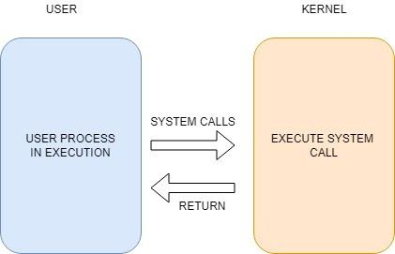

Slide 4
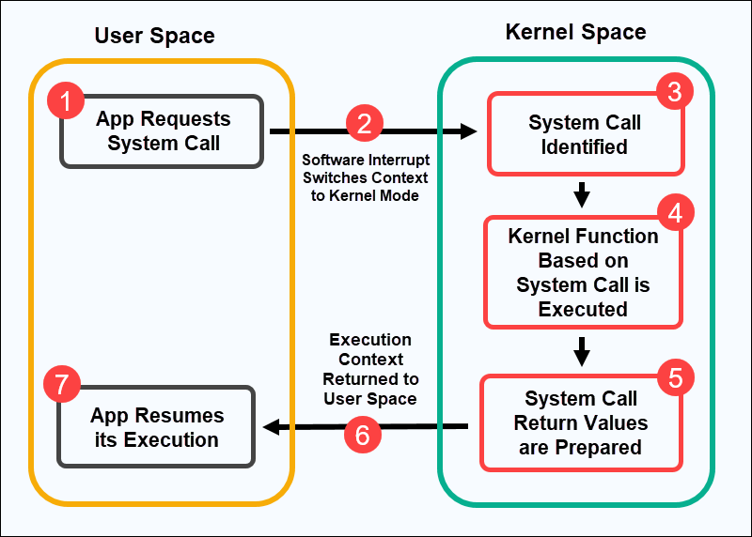
Working of a System call

Slide 5
Types of System Calls in OS
For any type of access, there are mainly 5 types of system calls in os :
File Management - system call that is used to handle the tasks related to files, such as the creation, deletion, writing, reading, releasing, etc.
Open(), Read(), Write(), Close()
Device Management - system call that is used to handle the tasks related to devices such as requesting the device, releasing the device, reading the device, logically attaching, and detaching the device.
ioctl(), read(), write()
Process Control - system call that is used to deal with the processes, such as the creation of process, deletion, execution, abortion of process, the wait signals for the process, etc.
Fork() ,Exit(), Wait()
Communications - system call that is used for communicating in between the processes, such as sending or receiving messages, creation and deletion of the communication connections, etc.
Pipe(), Shmget(), Mmap()
Information Maintenance - Information maintenance is a type of system call that is used for maintaining the information of the system such as setting up the date and time in the system.
Getpid(), Alarm(), Sleep()

Slide 6
System boot Process
Process that initializes a computers hardware and loads the OS when the system is powered on.
Power ON
CPU loads BIOS / UEFI
System Performs POST
BIOS locates and loads the boot loader .
Loads the OS kernel into memory.

